Slide 1
ITK Engineering
Partner | Creates | Perspectives

Slide 2










At a Glance
Continuous Growth
Global Footprint
Foundation: 1994
ITK Engineering AG
International
Rülzheim München
Stuttgart Ingolstadt
Frankfurt Marburg Braunschweig
Friedrichshafen (2014)
Graz
Barcelona
Detroit
Tokyo
Certified*
Awards*
DIN EN ISO 9001:2008
EN ISO 13485:2012
ISTQB Testers (International Software Testing Qualification Board)
IREB (Requirements Engineering)
FSCAE (Functional Safety Certified Automotive Engineers)
* Concerns ITK Engineering AG

Slide 3

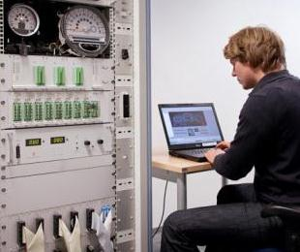

Consulting & Implementation from One Source
Technical Consulting
Innovation
Individual Method and Tool Consulting
Processes, e.g. Optimization, Automation
Engineering
Turnkey Systems
Software Development
Development Support
ITK Project Office or On-Site
Trainings
Inhouse and Public Trainings
Tools
Methods
Notes:
Wir sind der richtige Partner sowohl für Schulung und Beratung, als auch für die Umsetzung.
Das, was wir beraten, können wir auch umsetzen.

Slide 4
ITK Engineering
Automatic Release Introduction

Slide 5
Automatic Release Presentation
Agenda
Overview
Integration and activation inside a component
Steps and features of the automatic release process
Detailed description of each step/feature
Online demonstration
Questions
Change proposals
Summary

Slide 6
AutoRelease Overview
Features
Reduced manual user input
Comply with release process
Sandbox consistency check (member revisions, shared projects, local changes, etc.)
Automatic collecting information available from MKS (e.g. MKS paths, resolved issues)
Increasing version number
Re-compiling libraries to include new version number
Change package selection
Collecting RAM/ROM usages
Creating code handover document
Check-In new member revisions
Generating a checkpoint

Slide 7
AutoRelease Overview
Pre-Conditions
Network connection to MKS server (ports 7001 & 7002)
Sandbox is consistent
Released software component compiles with Scons
Variable part of AutoRelease configuration is made
Change package must exist (will not be created)
Component was tested on target hardware (runtime and stack usage is part of handover document)
At least the ECU evm hil targets have to be built (this calculates ram/rom usage)

Slide 8
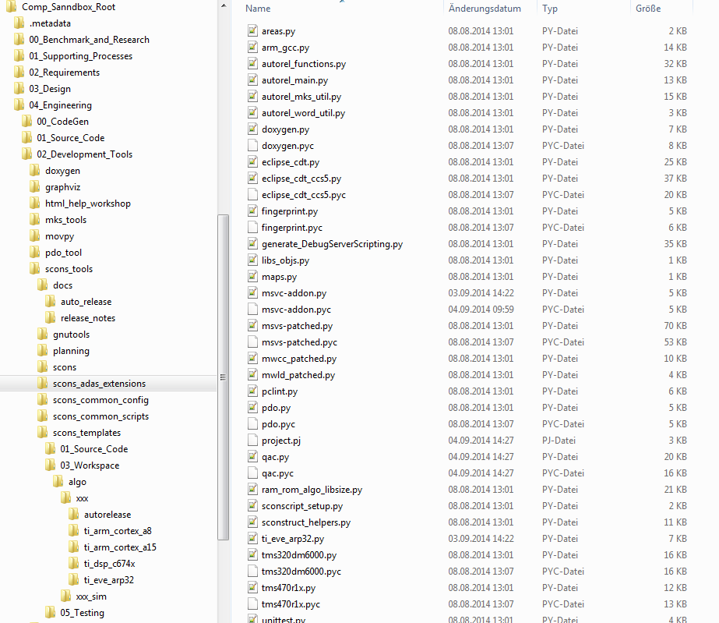
AutoRelease Overview
Python Scripts
Technical documentation
This presentation
Quick start documentation (to be created)
Configuration + Handover template

Slide 9
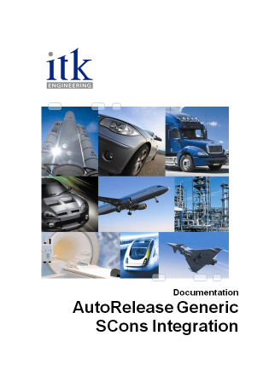
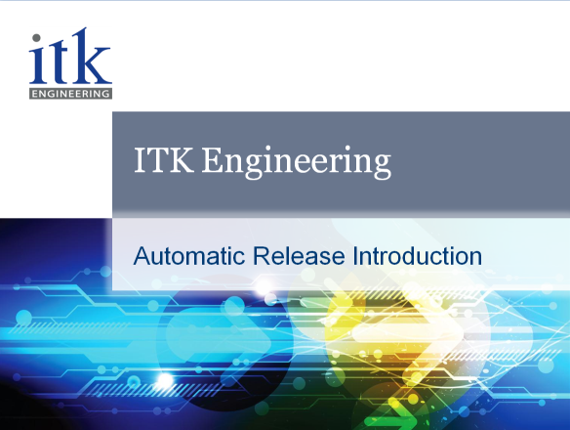
AutoRelease Documentation
Location: \04_Engineering\02_Development_Tools\scons_tools\docs\auto_release
Quick Start Guide
(this document)
(not yet existing)
Detailed & technical documentation

Slide 10
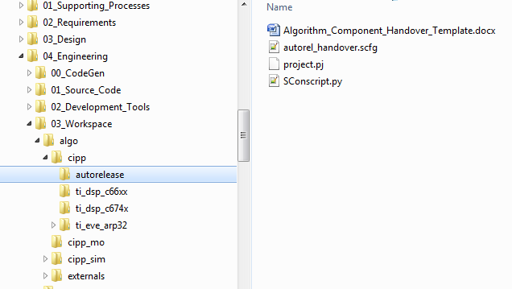
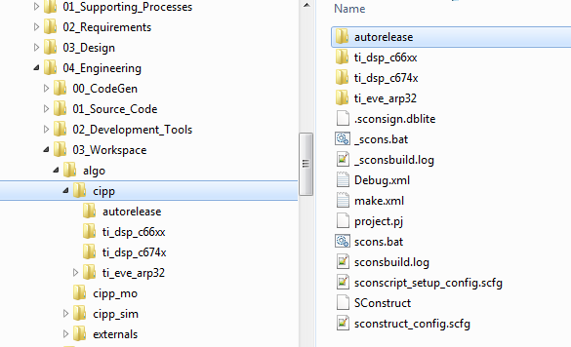
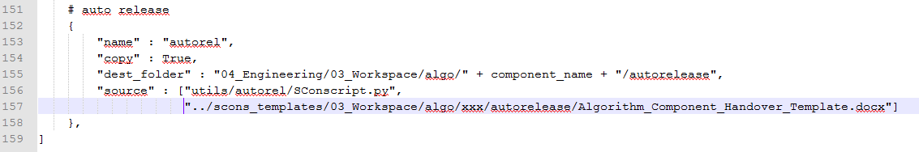
AutoRelease Integration/Activation
Use configuration template and add it to MKS!
Copy handover template and SCons script!
# activate auto release
autorel_support = True

Slide 11
AutoRelease Integration/Activation
> scons -?
Help
====
scons.bat [-c | -j N | -? | /? | define=define1 | TARGET]
-c Clean all targets
-j N Multicore build, whereat N is the amount of threads (e.g. scons.bat -j 4)
-? or /? This help output
define= Pass preprocessor define. Separate define with comma.
Example : define=define1,define2
TARGET One of the following targets:
all :Build all targets (except autorel)
cipp_algo :Build algo library
cipp_algo_ecu :Build ECU algo library
cipp_algo_ti_c674x :Build TI C674x algo library
cipp_sim :Build targets for PC simulation
cipp_sim_hil_ecu_out :Build ECU out files for eval board
cipp_sim_hil_out_ti_c674x :Build TI C674x out file for eval board
...
cipp_doxy :Build doxygen documentation
autorel :Perform complete automatic release process
The build target “autorel” is separated from “all”!
The command “scons autorel” starts the auto release script.

Slide 12
AutoRelease Configuration
Static configuration 1
#-------------------------------------------------------------------------------
# Root directory:
#
# Usually there is no reason to change it. Please check careful if the functions
# above are fulfilled before changing that preference.
#
sandbox_root = engineering_dir + "../"
#-------------------------------------------------------------------------------
# Component owner:
# Name of the owner. Free text that will be passed to the handover document.
#
component_owner = "Name of Owner"
#-------------------------------------------------------------------------------
# Configuration list file:
# The file name of the xml file containing the list of all xml files that are
# used for project configuration.
#
config_list_file = "shared_project_config_files.xml“
#-------------------------------------------------------------------------------
# Kind of delivery:
# Free text that will be passed to handover.
# "Library" or "Source"
#
kind_of_delivery = "Source"

Slide 13
AutoRelease Configuration
Static configuration 2
#-------------------------------------------------------------------------------
# Component release setups:
# List of available setups. The 'NAME' may be any string and proposed for
# selection in the beginning of the auto release process. 'DIRS' is a list of
# directories in "04_Build\algo\<component>_sim" that will be considered by the
# auto release script for that particular setup.
# 'BUILDS' is a list of SCons build target to be re-compiled when algo version
# number has been modified.
#
component_release_setups = (
{
'NAME':'CONFIG 1',
'DIRS':[],
'BUILDS':[],
},
)
# Example:
# component_release_setups = (
# {
# 'NAME':'C674x-ARP32',
# 'DIRS':['ti_c674x', 'ti_arp32'],
# 'BUILDS':['cipp_algo_ti_c674x_release', 'cipp_algo_ti_arp32_release'],
# },
# {
# 'NAME':'C66xx-ARP32',
# 'DIRS':['ti_c66xx', 'ti_arp32_vh28e1'],
# 'BUILDS':['cipp_algo_ti_c66xx_release', 'cipp_algo_ti_arp32_release'],
# },
# )

Slide 14
AutoRelease Configuration
Dynamic configuration 1
#-------------------------------------------------------------------------------
# Compliance report link:
# MKS-link to any compliance report. Free text that will be passed to the
# handover document.
#
compl_report_link = "n/a"
#-------------------------------------------------------------------------------
# Release list:
# Colon separated list of MKS release IDs. Those containing "Planned Requests"
# are investigated for realized or closed issues. Positive findings will be
# passed to the handover document. Non-release IDs will be ignored and a message
# is printed to the console.
#
release_id_list = []
# Example:
# release_id_list = [174366, 186012]

Slide 15
AutoRelease Configuration
Dynamic configuration 2
#-------------------------------------------------------------------------------
# Additional checkpoints:
# List
#
additional_checkpoints = []
# Example:
# additional_checkpoints = [
# {
# "LABEL":"AL_SR_WRP_03.00.14",
# "LINK":"http://mks-psad:7001/si/viewproject?projectName=/nfs/projekte1/REPOSITORY/Base%5fDevelopment/05%5fAlgorithm/SR%5fSignRecognition/04%5fEngineering/01%5fSource%5fCode/algo/00%5fCustom/sr%5fwrp/project.pj"
# },
# {
# "LABEL":"SW_COMMON_06.00.00_INT-4",
# "LINK":"http://mks-psad:7001/si/viewproject?projectName=/nfs/projekte1/REPOSITORY/Base_Development/05_Algorithm/CIPP_CommonImagePreProcessing/04_Engineering/01_Source_Code/common/rte/project.pj"
# },
# ]

Slide 16
AutoRelease Consistency Check
Member Check
The members in these sub-projects are checked recursive:
\04_Engineering\01_Source_Code
\04_Engineering\03_Workspace\algo\{component}*
\04_Engineering\05_Deliverables\include
\05_Testing\06_Test_Tools\mts_measurement\cfg
Types of detected inconsistencies:
NO WORKFILE - local file doesn’t exist
OUT OF SYNC – member revision is not working revision
LOCKED - locked by “me”
MODIFIED - local file differs from working revision
If this check fails the inconsistent files are printed to the console followed by the type of inconsistency.

Slide 17
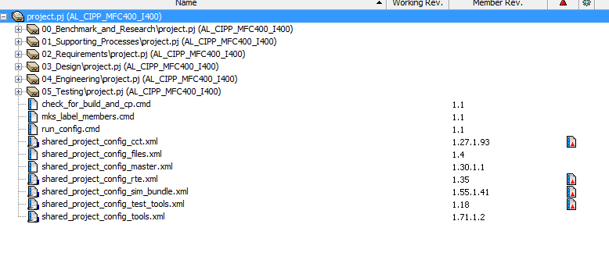
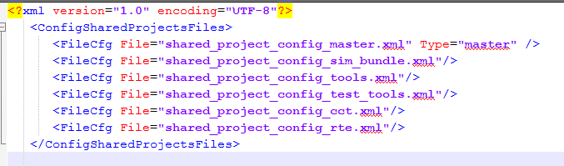
AutoRelease Consistency Check
Read Shared Project Configuration

Slide 18
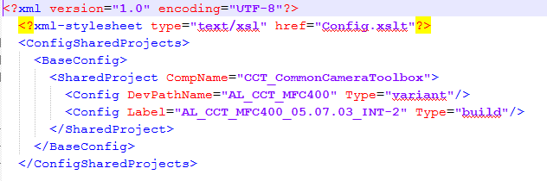
AutoRelease Consistency Check
Read Shared Project Configuration
<BaseConfig>
Overwrites
Only shared projects of type “build”
are considered!
<CustomConfig>
Overwrites
If label is not defined there is an MKS revision number!
<CustomConfigV2>
All defined shared projects occurring in the sandbox are listed in the code handover document.
<CustomConfigV3>
Not supported!

Slide 19
AutoRelease Consistency Check
Shared Project Configuration Check
All shared projects have to be of the type “build”
All project versions have to match the shared project configuration
If one of the list above is not met the script aborts and print’s an error to the console.
------------------------------------------------------------------------
---------- CONSISTENCY CHECK -------------------------------------------
------------------------------------------------------------------------
Checking members..............ok
Looking for shared projects...ok
Checking shared projects......failed
Compontent "GS_GlobalScheduler":
Found: Label="AL_GS_03.03.00_INT-32", Rev.=1.42
Exp : "AL_GS_03.03.00_INT-11"
Compontent "CANT_Cantata":
Found: Label="AL_EMO_01.23.01_INT-1", Rev.=1.2
Exp : "Revision 1.6"
The auto release script was terminated due to an error.
Error description: 2 inconsistent shared projects found.

Slide 20
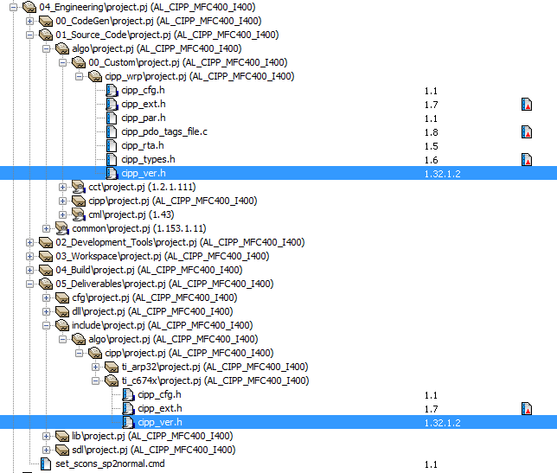
AutoRelease Consistency Check
Delivered include files
Looks for delivered include files that are shared from the same project (01_Source_Code).
The member revisions of both files must be equal.

Slide 21
AutoRelease User Input
Change package
Needed for locking members
Needed for checking members in
Must be existing, won’t be created
-----------------------------------------------------------------
---------- CHANGE PACKAGE SELECTION -----------------------------
-----------------------------------------------------------------
The selected change package will be used for locking members.
Existing open change packages:
------------------------------
[ 1] 178143:5 - ARM EVE Commnuication
[ 2] 178143:6 - Demo change package
[ 3] 178143:7 - One more demo CP
----
[ x] Exit (create a new change package)
Select one of the options above:

Slide 22
AutoRelease User Input
Setups (from auto release configuration)
Needed for …
SCons targets to be re-compiled
finding RAM/ROM usage information
libraries to be submitted
---------------------------------------------------------------------
---------- COMPONENT RELEASE SETUPS ---------------------------------
---------------------------------------------------------------------
Please select the setups you would like to release.
Select one setup, all setups or custom selection followed by <ENTER>.
[1] C674x-ARP32
[2] C66xx-ARP32
[3] CortexA8-ARP32
[a] All
[c] Custom
Select one of the options above:

Slide 23
AutoRelease User Input
Executed tests
Questions and yes/no answers
Will be passed to code handover document
Forces the user to answer the questions
------------------------------------------------------------------
------- COMPONENT INTEGRATION TESTS ------------------------------
------------------------------------------------------------------
Please answer the following questions.
Press 'y' or 'n' followed by <ENTER>.
Tested on SIL? [y/n] y
Tested on Evalboard? [y/n] y
Tested on ECU/Lab? [y/n] n
Tested on ECU/Car? [y/n] n

Slide 24
AutoRelease User Input
Type of delivery
“Source” or “Library”
Default value is stored in auto release configuration
“Source” is the value in the configuration template
Just answer with “y” for the default delivery type
However, the type can be changed later in the handover document
------------------------------------------------
---------- TYPE OF DELIVERY --------------------
------------------------------------------------
Is the delivery type 'Source' correct? [y/n] n
[1] Library
[2] Source
Select one of the options above: 1

Slide 25
AutoRelease User Input
Version label
Consists of a fix part, a version number and a variable text
Version number is taken from version header file
The range of version each segment is checked to be within 0-255
Free text may be any string (without white spaces)
Free text will be converted to upper case characters
Correctness of label must be confirmed
----------------------------------------------------------------
---------- INCREMENT VERSION -----------------------------------
----------------------------------------------------------------
Select the segment of the version number (3.3.3) to be raised:
[1] Major (=> 4.0.0)
[2] Minor (=> 3.4.0)
[3] Bugfix (=> 3.3.4)
----
[0] None (keep current version number)
Select one of the options above: 2
Enter description part of version label: AL_CIPP_03.04.00_test
Is the version label 'AL_CIPP_03.04.00_TEST' correct? [y/n] y

Slide 26
AutoRelease
Version header file
Will be modified
Modification requires re-build of library (build targets are defined in configuration)
The location of the version file is variable but shall meet the following rule: \04_Engineering\01_Source_Code\algo\...\{component_name}_ver.h
The format of the version header file has to be as shown below
The forth level (ALL_SW_BUG_FIX_LEV2) is not supported by the script and will be always 0 after modification.
To support the 4th level just a define in the script has to be changed
#define <COMP>ALL_SW_MAIN_VER_NO 0x??U
#define <COMP>ALL_SW_SUB_VER_NO 0x??U
#define <COMP>ALL_SW_BUG_FIX_LEV 0x??U
#define <COMP>ALL_SW_BUG_FIX_LEV2 0x??U

Slide 27
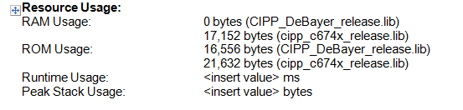
AutoRelease Memory Usages
Generate handover document from template
RAM/ROM usages are collected from the libsize files \04_Engineering\04_Build\algo\<comp>_sim\<target>\release
Only those libsize files are taken as configured in selected setup(s)
The result is passed to the code handover document separated by core
# RAM/ROM usage summary
lib=cipp_c674x_release.lib
ram=17152
rom=21632
unknown=0
total=38784

Slide 28
AutoRelease Issues
Issue lists
All issues that are connected to one release or multiple releases (taken from configuration)
Supported issue types are "Problem Report", "Feature Request" or "Change Request“
Only the following issue states are considered: 'Closed', 'Realized', 'Accepted', 'Analyzed‘ (see workflow)
The issue lists are separated by issue type
Each list is 1st ordered by state ('Closed‘ is first), then by ID number

Slide 29
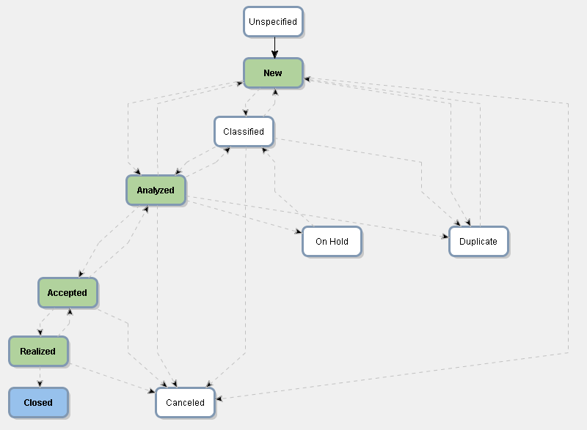
AutoRelease Issue Workflow
Considered issue states
The script assumes these issues to be realized (but the state was not updated).

Slide 30
AutoRelease Issues
Presentation in code handover document
ID number
Summary
State
Integrated Feature Requests:
187158 - CRCs checking in Ethernet packages [Closed]
187168 - DCM: STATUS_KLEMMEN [Closed]
187206 - Implement job STATUS_READ_ECU_TEMP [Closed]
187215 - DCM: Implement diag job READ_SWE_PROGRAMMING_STATUS [Closed]
187245 - STATUS_AUSSTATTUNG [Closed]

Slide 31
AutoRelease Re-Build
Compiled build targets
Since the version number has been modified, the libraries that are using it have to be recompiled
The build targets are taken from the auto release configuration
The script executes a new SCons build in the same working die where the auto release was started
The normal build output is printed to the console
The return value of the SCons script is evaluated. If ok, the script resumes, otherwise it terminates with an error
An error is not expected at this stage because the compile process must have been successful before

Slide 32
AutoRelease Locking Members
Single members
Version file
Component handover document
Paths
\04_Engineering\05_Deliverables\sdl\*
\04_Engineering\05_Deliverables\dll
\04_Engineering\05_Deliverables\lib\*
\05_Testing\06_Test_Tools\mts_measurement\dll\algo\<component>_sim
Special handling

Slide 33
AutoRelease Locking Members
SDL Files
Scanned for sub-paths starting with either "algo" or the architectures from the selected setups.
Example for CIPP:
\04_Engineering\05_Deliverables\sdl\algo\cipp
\04_Engineering\05_Deliverables\sdl\ti_arp32\algo\cipp
\04_Engineering\05_Deliverables\sdl\ti_c66xx\algo\cipp
\04_Engineering\05_Deliverables\sdl\ti_c674x\algo\cipp
Lib-Files
Scanned for paths containing the component name.
Example for CIPP:
\04_Engineering\05_Deliverables\sdl\algo\cipp
\04_Engineering\05_Deliverables\sdl\ti_arp32\algo\cipp
\04_Engineering\05_Deliverables\sdl\ti_c66xx\algo\cipp
\04_Engineering\05_Deliverables\sdl\ti_c674x\algo\cipp

Slide 34
AutoRelease Code Handover
Generate handover document from template
The script passes as much information as possible to the handover document automatically
However, there is still a need for manual modifications
The auto release script interrupts while the handover is open
Edit the document carefully! It is going to be submitted after closing. Before the document opens the user is informed about this.
For editing the script is stored her: \04_Engineering\04_Build\algo\{comp_name}
Finally it will be installed as \01_Supporting_Processes\01_Project_Management\05_Release\ Algorithm_Component_Handover_Template.docx
-------------------------------------------------------------------------------
---------- EDIT HANDOVER DOCUMENT ---------------------------------------------
-------------------------------------------------------------------------------
Please edit the code handover document. The script will not continue until the
document is closed. Since the document may not be changed later, make sure your
modifications are correct.
- PRESS ANY KEY TO CONTINUE -

Slide 35
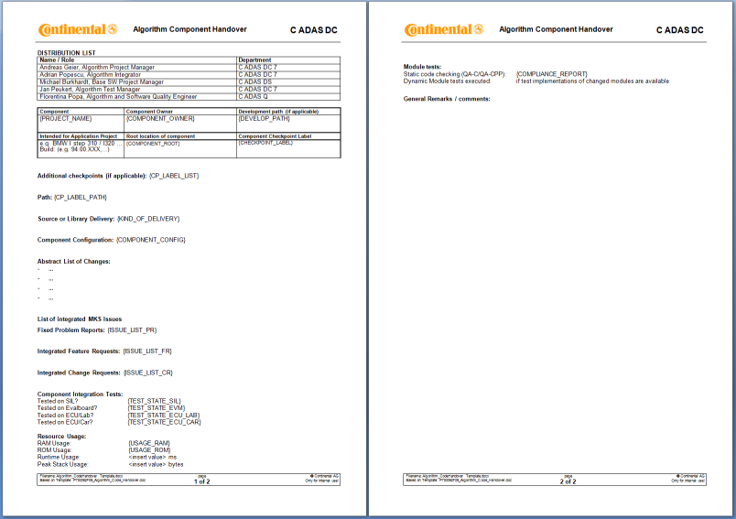
AutoRelease Code Handover
Template

Slide 36
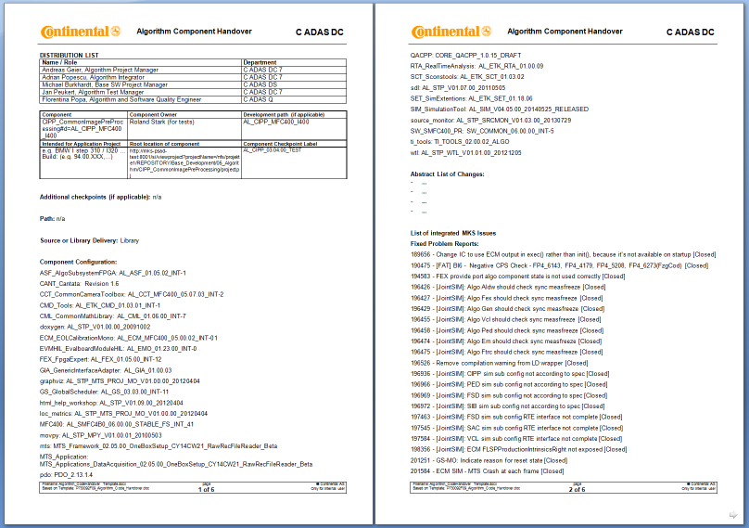
AutoRelease Code Handover
Example

Slide 37
AutoRelease Submit Release
Final steps
Before everything is committed the user is prompted to confirm this (see below)
Then the final steps “check-in”, “create checkpoint” and “label members” are performed.
All files that are locked will be checked in
A checkpoint using the label created previously is made
All members (except those in shared sub-projects) are labeled
If the version file is also delivered the member revision is updated.
---------------------------------------------------------------------------------
---------- SUBMIT CHANGES -------------------------------------------------------
---------------------------------------------------------------------------------
Would you like to submit the release? [y/n] y

Slide 38
AutoRelease Return Code
Status output
The auto release script returns with a numeric code
This code is also returned by SCons an may be used in batch files
There is also clear text output
This gives more information whether the script has been succeeded or failed
The auto release script was terminated due to an error.
Error description: 1 inconsistent files found.
scons: *** [D:\sandboxes\CIPP_AutoReleaseTest\04_Engineering\04_Build\algo\cipp\CIPP_AlgorithmCodeHandover_AutoRelease.docx] Error 1
scons: building terminated because of errors.
Build FAILED!!!!
Error Code
Detailed error description (clear text)

Slide 39
AutoRelease Return Code
List of return codes
Value | Label in script code | Description
0 | AUTOREL_OK | no errors
1 | AUTOREL_ERR_CONSCHECK | consistency check failed
2 | AUTOREL_ERR_LISTCHGP | getting change packages failed
3 | AUTOREL_ERR_VERFILE | the version file was not found
4 | AUTOREL_ERR_INVVERFILE | invalid version file format (unexpected content)
5 | AUTOREL_ERR_LOCKMEM | locking single member failed
6 | AUTOREL_ERR_LOCKDIRS | locking release paths failed
7 | AUTOREL_ERR_WRITEVERFILE | changing version file failed
8 | AUTOREL_ERR_LIBSIZE | libsize files were not found
9 | AUTOREL_ERR_REBUILD | rebuilding libs failed
10 | AUTOREL_ERR_HANDOVER | creating code handover document failed
11 | AUTOREL_ERR_INSTALL | the installation of the code handover failed
12 | AUTOREL_ERR_CHECKIN | check-in failed
13 | AUTOREL_ERR_CHECKPOINT | creating checkpoint failed
14 | AUTOREL_ERR_PROJCONF | parsing xml project configuration failed
15 | AUTOREL_ERR_INV_VERNUM | invalid version number (8 bit unsigned it expected) or max number 255.255.255 (not increasable)
16 | AUTOREL_ERR_ADD_HANDOVER | adding handover to MKS sandbox failed
17 | AUTOREL_ERR_NON_BUILD | shared sub-projects found that are not of type build
18 | AUTOREL_ERR_UPDT_VER_DELIV | updating delivered version file revision failed.
100 | AUTOREL_ERR_USERTERM_CP | user terminated the script at change package selection
101 | AUTOREL_ERR_USERTERM_CI | user terminated the script before committing the release

Slide 40

Questions

Slide 41
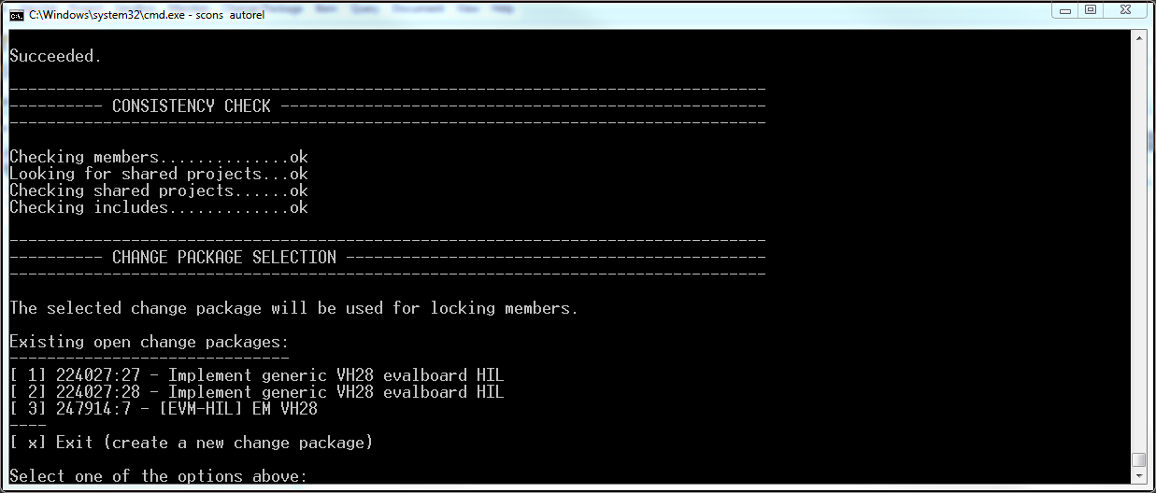
AutoRelease Online Demo

Slide 42

Auto Release Introduction
Thank you!

